Slide 1


OpenShift Sharks
Networking essentials

Slide 2
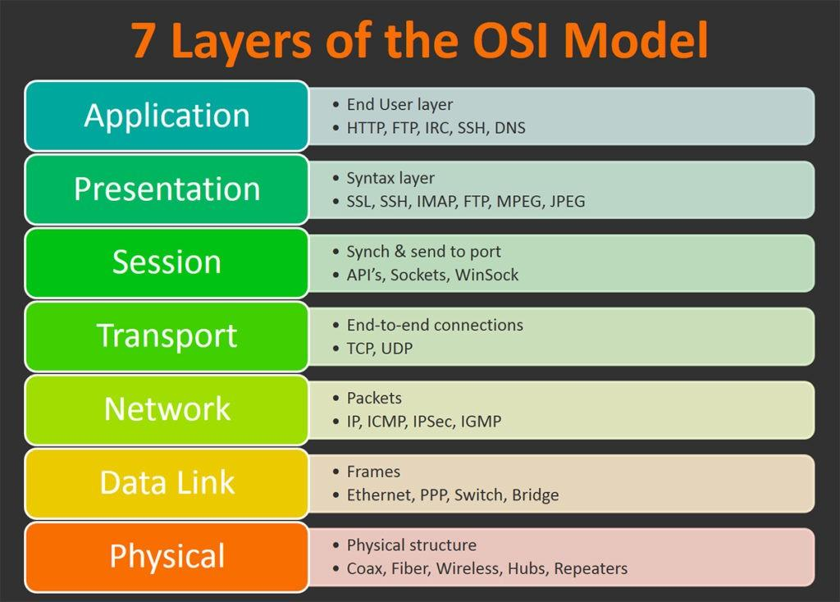
The OSI module
7 Layer Module
The Open Systems Interconnection (OSI) model is a conceptual model that characterises and standardized the communication functions of a telecommunication or computing systems without regard to its underlying internal structure and technology

Slide 3
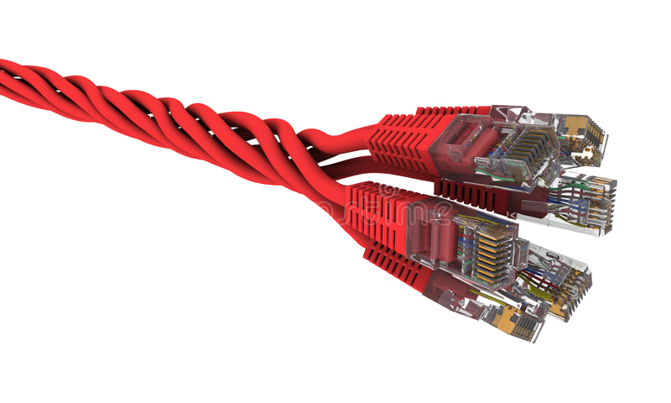

OSI Model - Physical Layer
Layer 1
Layer 1
The physical layer is responsible for the transmission and reception of unstructured raw data between a device and a physical transmission medium.
It converts the digital bits into :
electrical
radio
optical

Slide 4
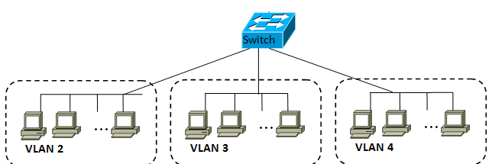
VLAN - Virtual LAN
Layer 2
Layer 2
A broadcast domain is a logical division of a computer network, in which all nodes can reach each other by broadcast at the data link layer.
A virtual LAN (VLAN) is any broadcast domain that is partitioned and isolated in a computer network at the data link layer (OSI layer 2)
Single BD for each VLAN
ֵMAC to MAC address communication
Security can leverage VLAN for network isolation
Frames

Slide 5
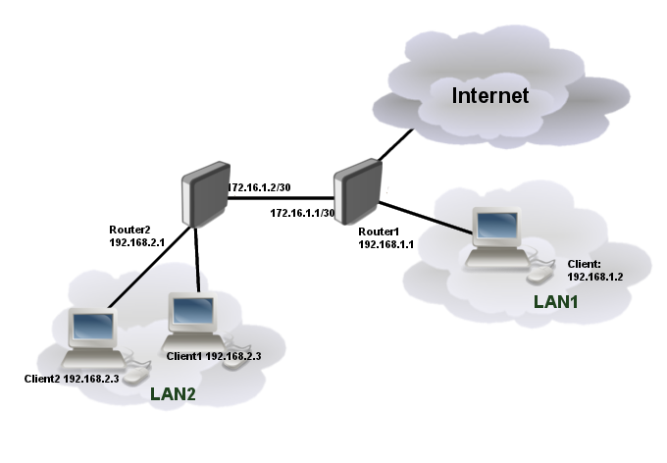
Network (Layer 3) - IP
Layer 3
Connects between multiple Broadcast domains.
IP routing is the application of routing methodologies to IP networks
In each IP network node, IP routing involves the determination of a suitable path for a network packet to its destination in an IP network
The route consists of :
Destination network
Destination subnet
Next hop
Packets
ARP

Slide 6
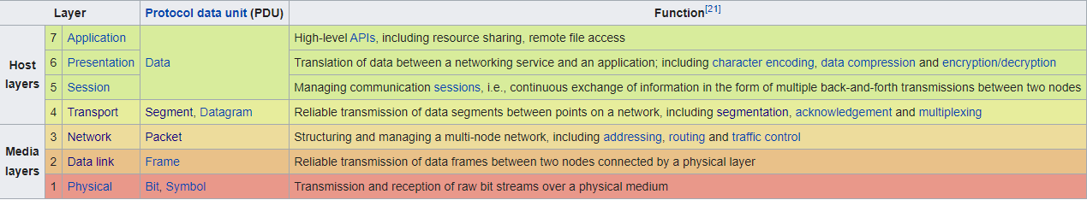
Transport layer - TCP/UDP
Layer 4
The transport layer provides the functional and procedural means of transferring variable-length data sequences from a source to a destination host, while maintaining the quality of service functions.

Slide 7
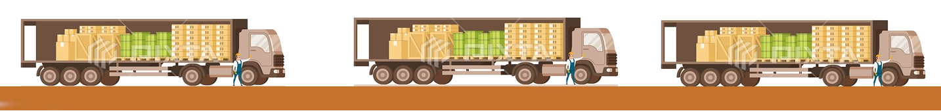
Network (Layer 4) - ‎Transport Layer
Layer 4
The protocols of this layer provide end-to-end communication services for applications
Responsible of Forming data segments and adding source and destination port numbers in the header of each transport layer data segment
The best-known transport protocol of the Internet protocol suite is the Transmission Control Protocol (TCP)
Connectionless User Datagram Protocol (UDP) is used for simpler messaging transmissions
There are much more L4 protocols which are implemented for various purposes like SCTP, ESP, etc..

Slide 8
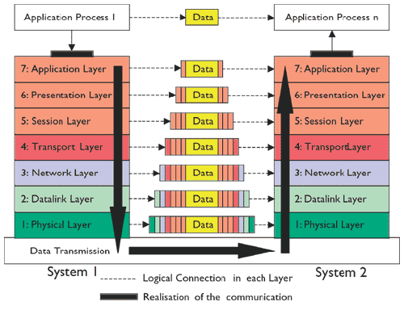
Packet transport
The following illustrates the way data is being sent from one host application to other through the OSI model

Slide 9
Transport Layer - Transmission Control Protocol (TCP) Protocol
Layer 4
provides reliable, ordered, and error-checked delivery of a stream of bytes between applications
Major internet applications runs on top of TCP ( SMTP, SNMP, FTP, HTTP, LDAP, Telnet, etc..)
Connection-oriented - connection between client and server (must be listening) is established before data can be sent
Three-way handshake (active open), retransmission, and error detection adds to reliability but lengthens latency
Detects lost, duplicated or out of order segments - requests re-transmission of lost data, rearranges out-of-order, even helps minimize network congestion
Once the TCP receiver has reassembled the sequence of octets originally transmitted, it passes them to the receiving application

Slide 10
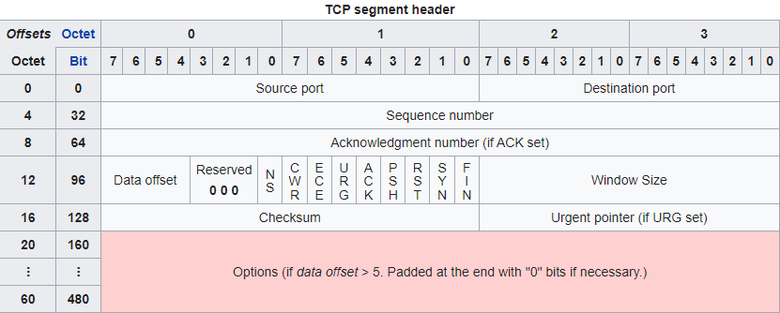
Transport Layer - TCP Segment header
Layer 4
Ports: well known - range from 0 to 1023. From 1024 to 65535 called High ports
Window size - size of the receive window. Specifies the number of bytes that the sender of this segment is currently willing to receive

Slide 11
Transport Layer - User Datagram Protocol (UDP) Protocol
Layer 4
Prior communications are not required in order to set up communication channels or data paths
Uses a simple connectionless communication model with a minimum of protocol mechanisms
Provides checksums for data integrity, port numbers for addressing different functions at the source and destination of the datagram
Has no handshaking dialogues, and thus exposes the user's program to any unreliability of the underlying network
No guarantee of delivery, ordering or duplicate protection
Time-sensitive applications often use UDP because dropping packets is preferable to waiting for packets delayed due to retransmission

Slide 12
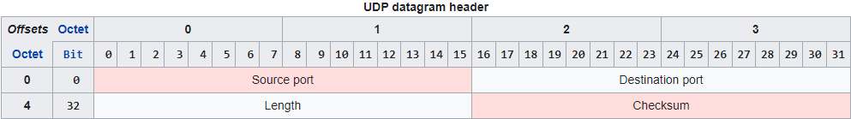
Transport Layer - User Datagram Protocol (UDP) Protocol
Layer 4
Purpose of Internet Control Messages Protocol is to provide feedback about problems in the communication environment. The ICMP messages typically report errors in the processing of datagrams
Transaction-oriented → Domain Name System, Network Time Protocol
modeling other protocols → VXLan, IP tunneling, RPC and NFS
Simple without a full protocol stack → DHCP, TFTP, DNS
Stateless lack of retransmission delays → IPTV, Voice over IP and RTSP
Supports Multicast

Slide 13
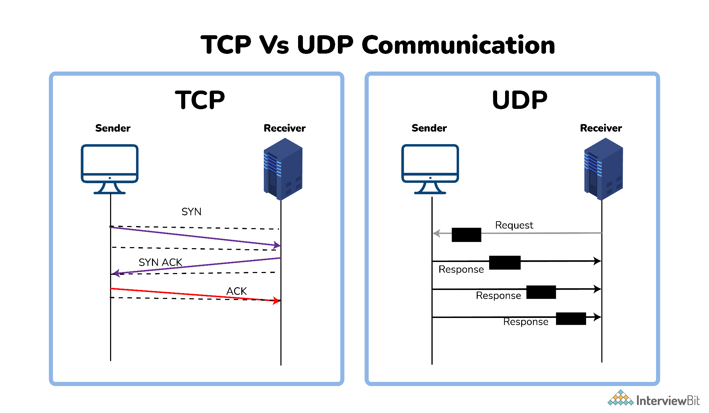
Layer 4

Slide 14
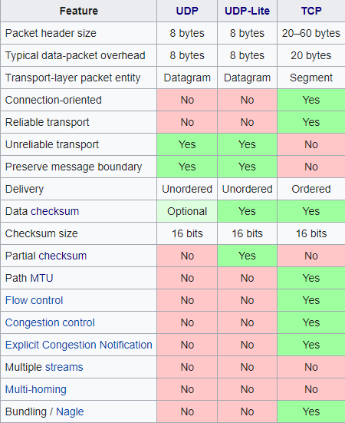
TCP vs UDP Features
Layer 4

Slide 15
Moving on..
Red Hat is the world’s leading provider of enterprise open source software solutions. Award-winning support, training, and consulting services make Red Hat a trusted adviser to the Fortune 500.

